Slide 1
Server-side Programming
Requests and Unit Testing

Slide 2
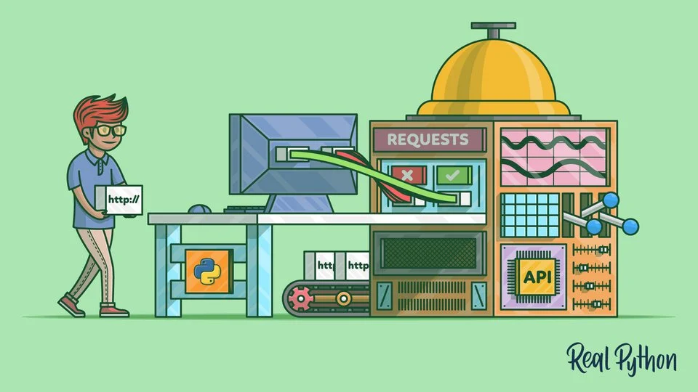
Requests
Getting HTTP data in Python

Slide 3
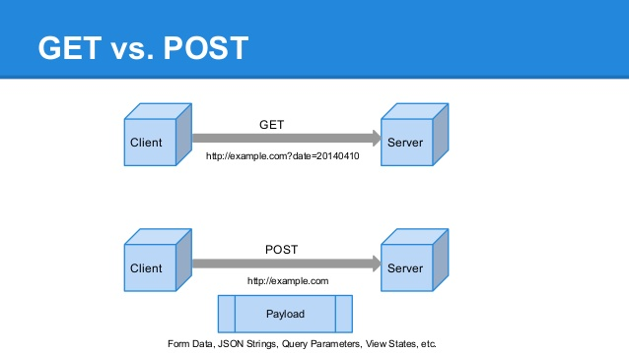
Recall HTTP requests
GET and POST allow us to communicate with webservers via a URL
Get fetches information
Post sends information
Status codes are returned

Slide 4

Requests simplifies talking over HTTP
Handles GET and POST
Returns results in multiple formats (including JSON)
Handles authentication
Returns status HTTP status codes
Useful for talking with REST APIs

Slide 5
get method takes the url
request.get() takes the url to connect to
response. status_code contains an HTTP status code
response.text contains the text body
import requests
url = "https://www.dawsoncollege.qc.ca"
resp = requests.get(url)
print(resp.status_code) # 200
url = "https://www.dawsoncollege.qc.ca/test"
resp = requests.get(url)
print(resp.status_code) # 404

Slide 6
URL parameters are separated in get()
params= contains KVP of parameters
Flexible for the API being used
Response can be retrieved as JSON
Can access elements directly as a dict
# Using search params
response = requests.get(
'https://api.github.com/search/repositories',
params={'q': 'requests'}
)
json_txt = response.json()
repo = json_txt['items'][0]
print(repo['name']) #requests
print(repo['description'])
# A simple, yet elegant, HTTP library.

Slide 7
Requests and playing with REST APIs

Slide 8
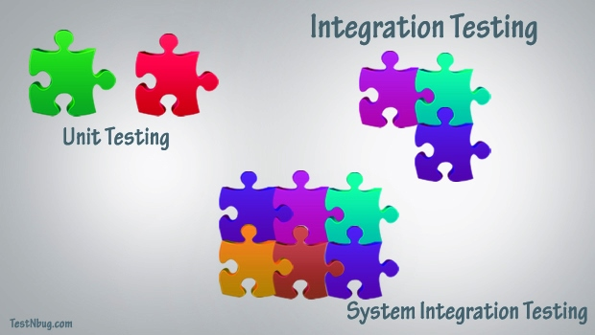
Different levels of software testing exist
Unit Testing
Integration Tests
End to End Tests

Slide 9

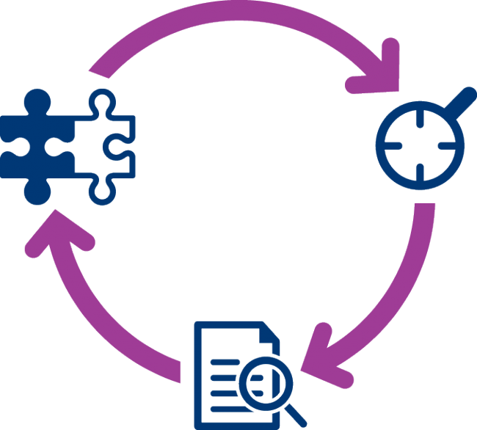

Unit testing is a powerful validation tool
Repeatable
Systematic
Automated

Slide 10
Python has built-in unit testing
unittest provides the functionality for creating test cases
Test classes derive from the TestCase class
Asserts let us check values
Test functions must start with the word test
import unittest
import function_demo
class TestFunctionDemo(unittest.TestCase):
def test_add(self):
expected = 3
result = function_demo.add(1, 2)
self.assertEqual(result, expected)
if __name__ == '__main__':
unittest.main()

Slide 11
Recall we only unit-test public items
class Bag: # Class definition
max = 5 # Class variable (attribute)
def __init__(self): # Initalizer
self.data = [] # Instance variable
self.__count_val = 0
def __count(self):
self.__count_val +=1
def add(self, x): # Instance method
self.data.append(x)
self.__count()
def change_max(x): # Non-instance method
Bag.max = x
class TestObjectDemo(unittest.TestCase):
def test_bag(self):
bag = Bag()
bag.add(1)
self.assertEqual(len(bag.data), 1)
self.assertEqual(bag.data[0], 1)

Slide 12
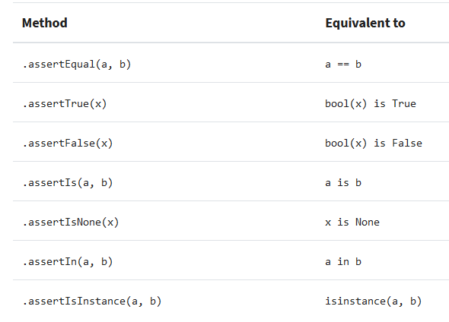
There are many assert methods
def test_asserts(self):
a = 1.13
b = 1.12
self.assertNotEqual(a,b) # Passes
self.assertAlmostEqual(a, b, 1) # Passes
self.assertIsNot(a, int) # Passes

Slide 13
Tests are grouped inside a class
class TestFunctionDemo(unittest.TestCase):
def test_add(self):
expected = 3
result = function_demo.add(1, 2)
self.assertEqual(result, expected)
def test_sub(self):
expected = 1
result = function_demo.sub(2,1)
self.assertEqual(result, expected)

Slide 14
Tests can be run in the command line
Running command line
Output in Console
rem Discovers the tests in the dir
python -m unittest discover
rem Runs the test in a file
python -m unittest test_demo.py
....
----------------------------------------------------------------------
Ran 4 tests in 0.001s
OK

Slide 15
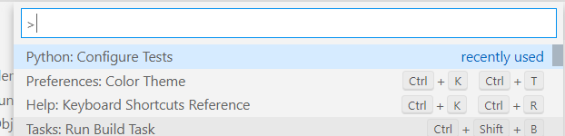
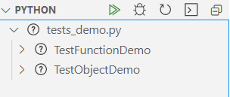
IDEs can run tests as well
VS Code can also run test cases
You need to configure the tests

Slide 16
Testing REST API with Unit testing
Install flask-unittest
Create unit tests for the REST API

